Slide 1


Slide 2
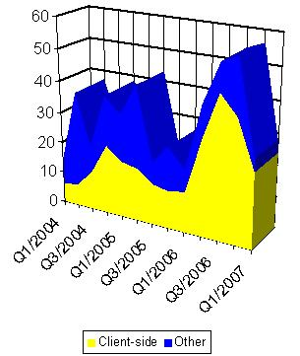
Vulnerability Landscape
In 2006 the patches for client-side vulnerabilities overcame other categories in Microsoft software.
In 2010, Symantec’s Global Internet Security Threat Report indicated that over 93% vulnerabilities exploited worldwide are now client-side
Source: http://www.symantec.com

Slide 3
Protecting the Client
Client-side attacks have special properties compared to traditional server-side attacks
Extremely complex structures for document formats
Embedding of interpreters and scripting languages
Embedding of arbitrary formats within other container formats
Obfuscation techniques
Multiple delivery channels for the same vulnerability

Slide 4
Network Intrusion Prevention Systems
Intrusion prevention platforms are evaluated by market analysis firms according to two criteria
Throughput
Coverage
A key term in modern IPS is deep packet inspection but implementation is practically limited by the main two evaluation criteria
A supplemental system is required to defend against client side attacks

Slide 5
Razorback Framework
Razorback is a distributed data collection and analysis framework
Modular architecture allows for collection and analysis modules to be distributed over a network in arbitrary configurations
Retrieval of data over the wire or from server software after delivery
Analysis of complex file formats distributed over a server farm

Slide 6
Razorback Framework
A collection of elements working together
Each element performs a discrete task
Elements are tied together via the Dispatcher
Nugget types:
Data Collection
Data Detection/Analysis
Output
Intelligence
Correlation
Defense Update
Workstation

Slide 7
Razorback Framework Architecture
Database
Collection Nugget
Detection Nugget
Collection Nugget
Detection Nugget
Collection Nuggets
Detection Nuggets
Dispatcher
Other Types of Nuggets
Output Nugget
Output Nugget
Output Nuggets

Slide 8
Database
Configuration information
Event information
Contextual information
Metadata
Provides a wealth of information for correlating events and activities
Notes:
Contains a lot of what you’d expect -- configuration and event/alert information as well as non-event yet interesting trending and analysis data that has been generated by the nuggets

Slide 9
Nuggets
Dispatcher Registration
Types of data handled
Types of output generated
UUIDs
Identifier of nuggets
Type of nugget
Types of data handled and/or provided
Allows for easy addition and removal of elements
Notes:
UUIDs because It’s easy to add and remove elements from the system
Makes it easy for users to create and manage custom nuggets specific to their environment

Slide 10
Nugget Registration
Detection Nugget
Collection Nugget
Dispatcher
Output Nugget
Detection Nugget

Slide 11
Collection Nugget
Capture data
From the network
From a network device directly
From log files
Contact dispatcher for handling
Has this data been evaluated before?
Send the data to the Dispatcher
Notes:
The great thing about the Razorback Framework is that anything can be a collector. It doesn’t have have to be limited to network sniffers. A collector nugget can be tightly integrated with a mail server or a Web proxy. A DNS server. Even a user’s host machine. It just needs to register with the dispatcher and provide data.
Once the data is sent to the Dispatcher, assuming it hasn’t been analyzed previously, it’s sent to … <relevant detection nuggets>

Slide 12
Collection Nuggets
Snort-as-a-Collector (SaaC)
SMTP mail stream capture
Web capture
DNS capture
Custom post-mortem debugger
Traps applications as they crash
Sends the file that triggered the crash to Dispatcher
Sends the metadata of the crash to the Dispatcher

Slide 13
Detection Nugget
Handles incoming data from Collection Nuggets
Splits incoming data into logical sub-blocks
Requests additional processing of sub-blocks
Provides alerting feedback to the Dispatcher
Notes:
Relevant detection nuggets.
Detection nuggets are where a lot of magic happens. Because we are not trying to do detection at line speed, we are free to do full, in-depth file analysis. When sub-blocks of other types of data such as image files in Word documents or Javascript in PDFs, those sub-blocks are sent back to the Dispatcher for further analysis. Sub-blocks are sent as “fire and forget;” the detection nugget won’t get the results back. But the Dispatcher and correlation engines will aggregate the data to relate sub-block information with the source data.

Slide 14
Detection Nuggets
Zynamics PDF Dissector
Deobfuscation and normalization of objects
Target known JavaScript attacks
JavaScript Analyzer (w/ Zynamics)
Search for shellcode in unescaped blocks
Look for heap spray
Look for obvious obfuscation possibilities
www.zynamics.com/dissector.html

Slide 15
Detection Nuggets
Shellcode Analyzer (w/ libemu)
Detection and execution of shellcode
Look for code blocks that unwrap shellcode
Win32 api hooking
Determine the function call
Capture the arguments
Provide alerts that include shellcode action
libemu.carnivore.it
Notes:
Shellcode Analyzer
Speaking of which, I just have to take the opportunity to tout yet another useful tool called libemu -- a link to which we'll also provide at
end of this presentation. Libemu is a library that offers x86 emulation and shellcode detection and execution capabilities. Some noteworthy
capabilities are the win32 api function call hooking, much like the javascript function call hooking we talking about earlier, we can also
look for blocks that unwrap shellcode and profile shellcode behavior, the latter of which allows us to construct meaningful alerts about
what that shellcode was written to do.

Slide 16
Detection Nuggets
Office Cat Nugget
Full Office file parsing
Vuln-centric detection against known threats
SWF Nugget
Decompresses and analyzes flash
Detects known flash threats
Notes:
Office Cat Nugget
We've also set up an Office Cat nugget.
For those of you not in the know, office cat is the name of an ongoing VRT command-line utility that can be used to process Microsoft Office
Documents and detect the triggering conditions for known vulnerabilities. It was probably one of our earlier attempts at addressing the
issue of complex client-side attacks that would require full parsing to address accurately and reliably.
And... a flash nugget. The flash nugget can decompress and analyze flash files, allowing it to then probe for, locate and flag known threats.
Very cool stuff.

Slide 17
Detection Nuggets
ClamAV Nugget
Analyze any format
Signature- and pattern-based detection
Updatable signature DB
Can further serve as a collector
Can issue defense updates
Notes:
<<Due to the nature of data collectors, this now means ClamAV is freed from only handling SMTP and can now handle Web or any other data source.>>
ClamAV Nugget
ClamAV in nugget format! Robust, customizable antivirus that is capable of dealing with any format. There is signature-based detection
but it also support more logical, pattern-based detection in the form of ndb and ldb files. These database files are updatable on box
via a utility called freshclam and custom signatures can be written. The last point is of particular interested because it allows the
nugget to issue defense updates in the form of new signatures should another nugget flag a previously undetected file as bad.

Slide 18
Output Nugget
Receives alert notification from Dispatcher
If alert is of a handled type, additional information is requested:
Short Data
Long Data
Complete Data Block
Normalized Data Block
Sends output data to relevant system
Notes:
When an alert is generated, the Dispatcher tells all Output nuggets that a new alert has been generated. If it’s a type of alert that the nugget is interested in, it will request any or all of the available detailed data that is available for the event. Of these types, I want to highlight the Normalized Data Block.
The normalized data block is the decoded or de-obfuscated data that actually allowed the alert to happen. This greatly eases the burden of event analysis by not being presented with a blob of compressed data, for example.
Once any additional information is received, the Output Nugget send its formatted data to the appropriate reporting system.
The next few nugget types I’m going to talk about are less about the standard “alert on bad stuff” paradigm and more about providing additional analysis of events and activites in your environment.

Slide 19
Output Nuggets
Deep Alerting System
Provide full logging output of all alerts
Write out each component block
Include normalized view of documents as well
Maltego Interface
Provide data transformations targeting the Razorback database
www.paterva.com
Notes:
Output
As far as output goes, the system offer detailed, context-oriented alerting. This includes timestamps, short and long version of the captured
data, as well as source IPs (and urls for web traffic). Component blocks within files that trigger alerts can be normalized and reported as
such. For example, a PDF with a stream of compressed javascript can be flated and reported as the component that triggered the alert. This
supports the functions of forensics and incident response for the analyst by exposing them the full contextual gamut of data they need to
respond to an attack.
Maltego
We need to mention Maltego here, again linked to at the end of the presentation.
Maltego is an open source intelligence and forensics application. It will mine data and aggregate information and represent relationships
between those data visually. Because of this ability to mine and relate data, depending on how deeply you take advantage of the abilities
of the application, maltego can be used in the development of those correlation nuggets we talk about earlier. Very handy.

Slide 20
Analysis Nuggets
Intelligence Nugget
Generate metadata for correlation
Correlation Nugget
Compare results of various intelligence nuggets
Notes:
The Intelligence Nugget is primarily a generator of metadata and logging of activities within your environment. An example would be the DNS nugget that we have developed. It simply provides a mechanism of logging all DNS queries in your network. While this is not a security risk in itself, … <An appropriate Correlation Nugget>
An appropriate Correlation Nugget could use that data to track an attacker or malware to find affected hosts that make similar DNS queries.
Detect trending data
Identify “hosts of interest”
Track intrusions through the network
Initiate defense updates

Slide 21
Defense Update Nugget
Receives update instructions from dispatcher
Performs dynamic updates of network device(s)
Update multiple devices
Update multiple devices of different types!
Notifies dispatcher of defense update actions
Notes:
…updates of network devices to limit exposure or contain an infection. What’s really cool about the defense update nuggets is that they are vendor agnostic – you can have a single nugget update any number of devices from any number of vendors and you can even have it update devices of different types concurrently. For example, you could update your router to redirect an attacker to a honeynet and tell your daemon loggers to log all traffic from the offending hosts.
And finally…

Slide 22
Workstation Nugget
Authenticates on a per-analyst basis
Provides analyst with ability to:
Manage nugget components
Manage alerts and events
Consolidate events
Add custom notes
Set review flags
Delete events
Review system logs
Notes:
We have the Workstation Nugget. In addition to managing configuration information and maintaining the health of the system, Workstation Nuggets can provide mechanisms for analysts to provide manual consolidation of events, notes about events, and provide workflow data regarding the analysis of the available data. It really helps analyst teams work more efficiently and effectively.

Slide 23
Dispatcher Operation
Database
Detection Nugget
Javascript
Analysis
4
Detection results
Alert/Event data
Embedded sub-component data
3
Dispatcher
2
Detection Nugget
Embedded sub-component data
Detection results
1
Collected data
PDF Analysis
Notes:
<<Show same type of file being sent to multiple detection nuggets.>>

Slide 24
DEMO

Slide 25
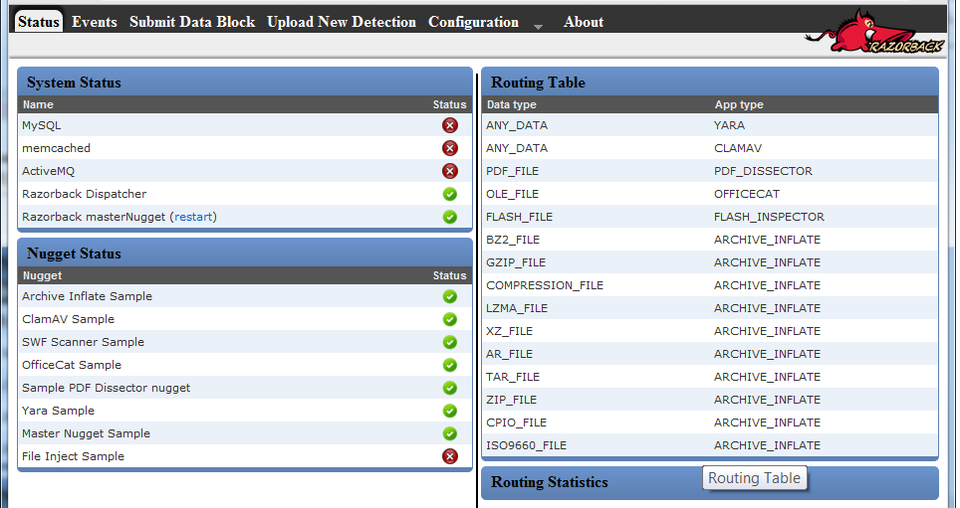

Slide 26
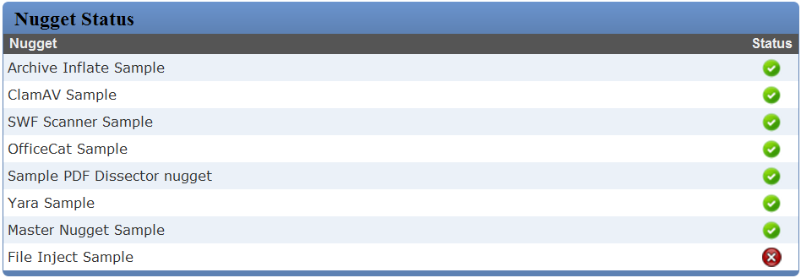

Slide 27
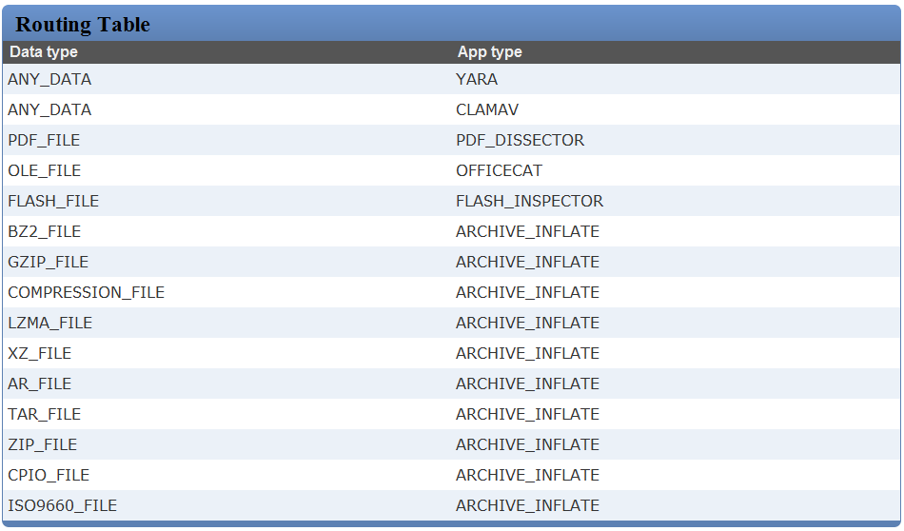

Slide 28
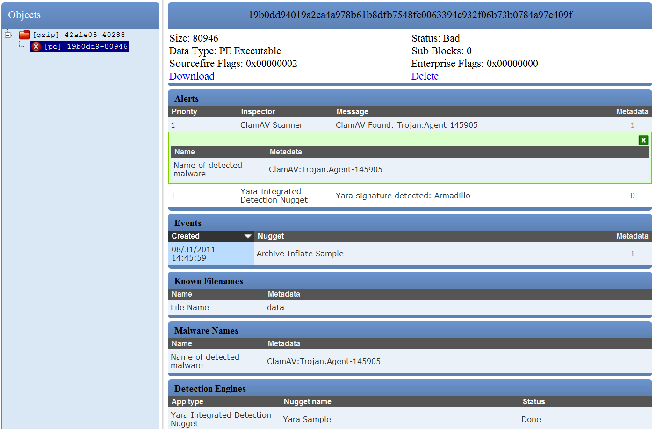

Slide 29
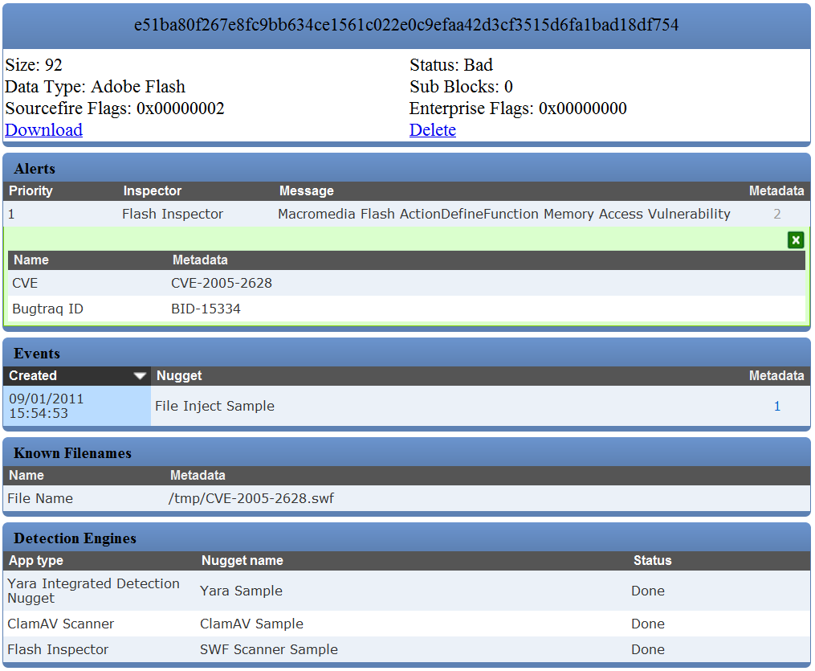

Slide 30
Contact
Richard Johnson
rjohnson@sourcefire.com
@richinseattle
http://rjohnson.uninformed.org
Sourcefire VRT
labs.snort.org
vrt-sourcefire.blogspot.com
@VRT_Sourcefire
Razorback Team:
Alex Kambis
Alex Kirk
Alain Zidouemba
Christopher McBee
Kevin Miklavcic
Lurene Grenier
Matt Olney
Matt Watchinski
Nigel Houghton
Patrick Mullen
Ryan Pentney
Sojeong Hong

